Slide 1
CELL & MOLECULAR BIOLOGY FOR BIOINFORMATICS SEBB 4173 Chapter 1 : Cell Wall
Dr. Noor Hidayah

Slide 2
The Cell Wall of Prokaryotes
Turgor pressure inside prokaryotic cell is about 2 atm, equivalent to an automobile tire.
So bacteria have to have cell wall which also function to give shape and rigidity to cell.
Bacteria can be divided into two groups;
Gram negative
Gram positive
Turgor Pressure or turgidity = the main pressure of the cell contents against the cell wall in plant cells and bacterial cells
Notes:
Gram from Hans Christian Gram, a Danish bacteriologist

Slide 3
Gram Negative and Gram Positive Bacteria
The cell wall of…
The gram(-): a multilayered structure and quite complex.
The gram(+): primarily a single type of molecule and is often much thicker.
So you’ll see…
A significant textural difference between the surfaces of gram(+) and gram(-) bacteria.

Slide 4
Peptidoglycan
Peptidoglycan
Membrane
Membrane
Periplasm
Outer membrane (lipopolysaccharide and protein)
Gram positive
Gram negative

Slide 5
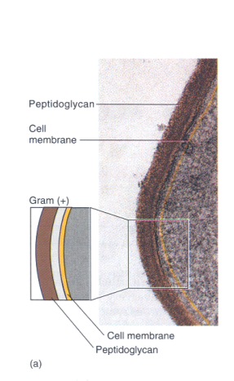
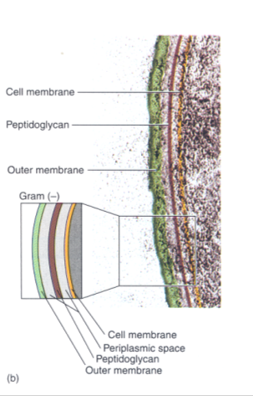
Electron Micrograph of Cell Walls

Slide 6
Peptidoglycan
One rigid layer primarily responsible for the strength of the wall.
Besides peptidoglycan, additional layers are present outside this rigid layer, in most bacteria.
Peptidoglycan of both Gram(-) and Gram(+): very similar in chemical composition.

Slide 7
Chemically…
Peptidoglycan (or murein), is a thin sheet composed of two sugar derivatives:
N-acetylglucosamine (NAG) and
N-acetylmuramic acid (NAM) also
a small group of amino acids consisting of L-alanine, D-glutamic acid, D-alanine, and either lysine or diaminopimelic acid (DAP)
Notes:
Peptidoglycan is a polysaccharide made of two glucose derivatives, N-acetylglucosamine (NAG) and N-acetylmuramic acid (NAM), alternated in long chains. The chains are cross-linked to one another by a tetrapeptide that extends off the NAM sugar unit, allowing a lattice-like structure to form. The four amino acids that compose the tetrapeptide are: L-alanine, D-glutamine, L-lysine or meso-diaminopimelic acid (DPA), and D-alani

Slide 8
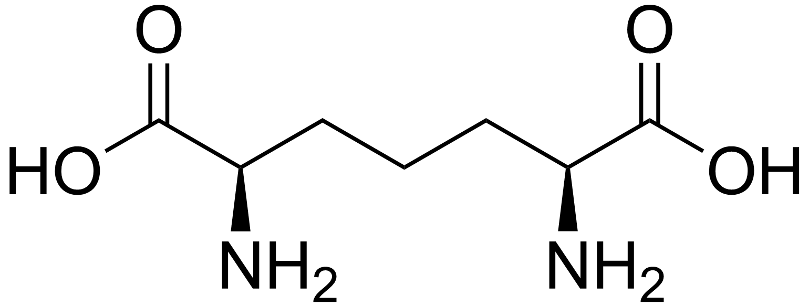
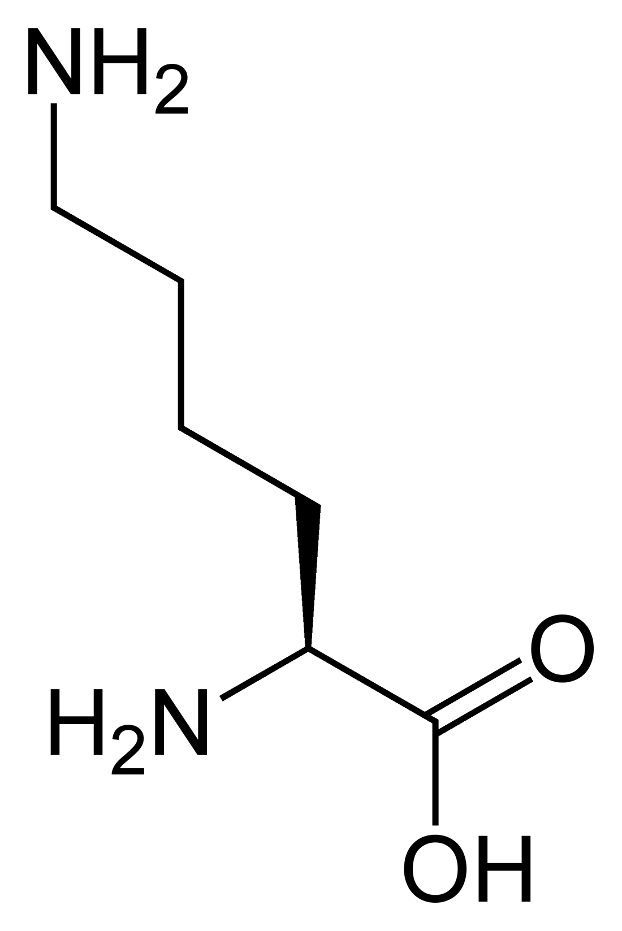
Diaminopimelic acid (DAP)
Lysine (Lys)
Notes:
Diaminopimelic acid (DAP) represents an epsilon-carboxy derivative of lysine.

Slide 9
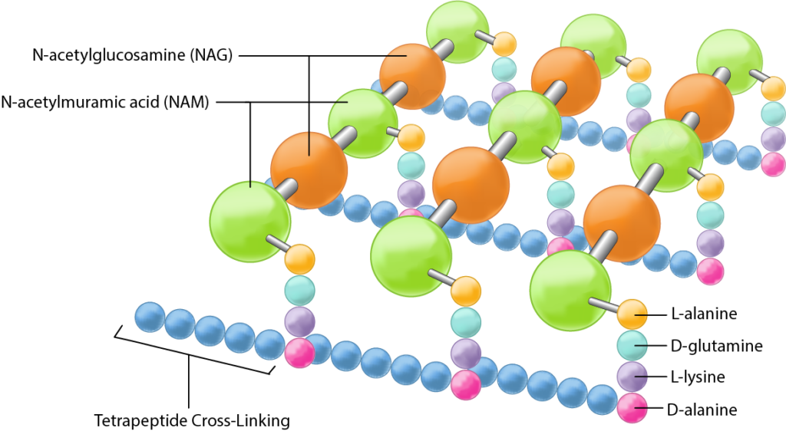

Slide 10
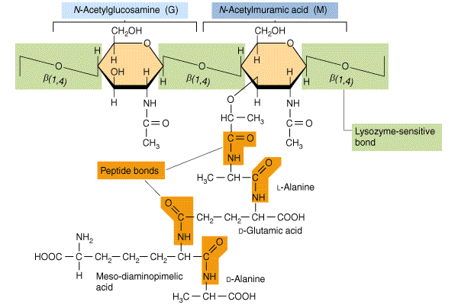
http://microbiology.okstate.edu/faculty/demed2/lecture_notes/text%20figures/peptido.gif

Slide 11
Origin of the Rigidity and Strength of the Peptidoglycan
It has glycosidic bonds connecting the sugars in the glycan chains. They are very strong!
But these bonds alone cannot provide rigidity in all directions.
The full strength is obtained when these chains are cross-linked by amino acids.
Different bacteria has different x-linking extent.
Greater rigidity coming from more complete x-linking.

Slide 12
In Gram(-): x-linkage is by direct peptide Iinkage of the amino group of DAP to the carboxyl group of the terminal D-Ala.
The Gram(+): x-linkage is usually by a peptide interbridge.
The kinds and numbers of x-linking amino acids varies from organism to organism.

Slide 13
Glycan Backbone
G
M
G
│
L-Ala
│
D-Glu
│
DAP
│
D-Ala
G
│
L-Ala
│
D-Glu-NH₂
│
L-Lys
│
D-Ala
M
G
Peptides
D-Ala
│
DAP
│
D-Glu
│
D-Ala
│
Gly
│
Gly
│
Gly
│
Gly
Gly
Interbridge
G
M
G
Escherichia coli
(gram negative)
│
D-Ala
│
L-Lys
│
D-Glu-NH₂
│
L-Ala
│
G
M
G
Staphylococcus aureus
(gram positive)

Slide 14
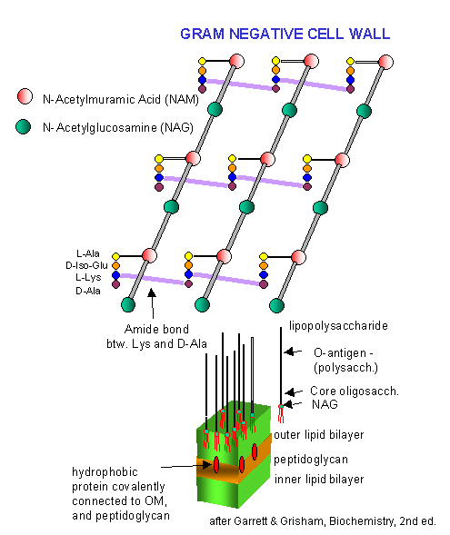
DAP

Slide 15
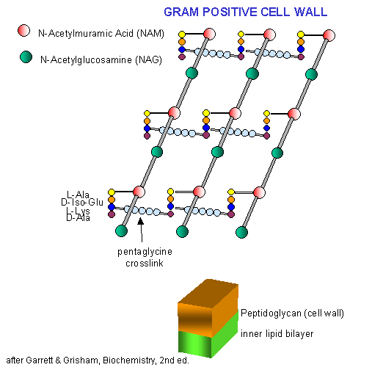

Slide 16
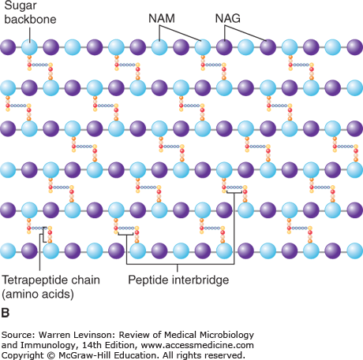

Slide 17
Differences between Gram(+) and Gram(-) and the Complexity
In Gram(+): as much as 90% of the cell wall consists of peptidoglycan.
Many bacteria, especially Gram(+), have several (up to about 25!) peptidoglycan layers.
In Gram(-): about 10% is peptidoglycan, the majority of the wall consisting of a complex layer.

Slide 18
Diversity in Peptidoglycan
The shape of both gram(+) and gram(-) cells is be determined by:
Lengths of the peptidoglycan chains.
The manner and extent of x-linking of the chains.
Peptidoglycan is present only in bacteria.
NAM and DAP are never found in the cell walls of Archaea or Eukaryotes.
Not all bacteria have DAP in their peptidoglycan.

Slide 19
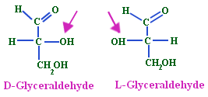
DAP (diaminopimelic acid): present in ALL gram(-) bacteria, in SOME gram(+) species.
Most gram(+) cocci have lysine instead of DAP.
Other gram(+) bacteria have other amino acids.
Bacterial cell wall also has two amino acids that have the D-configuration, D-Ala and D-Glu.
In proteins, amino acids are always of the L-configuration.

Slide 20
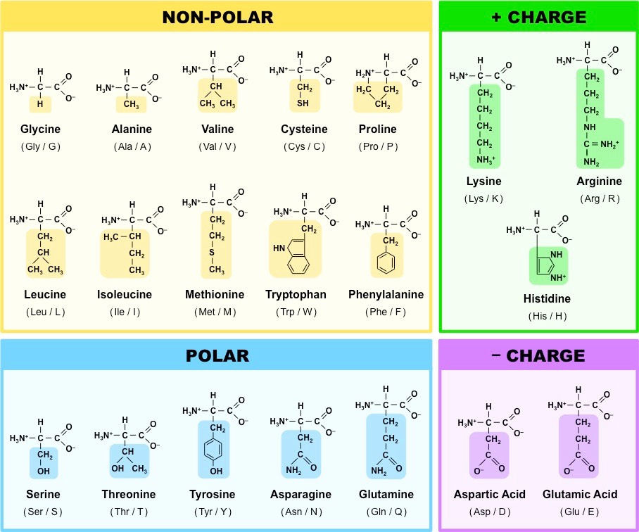

Slide 21
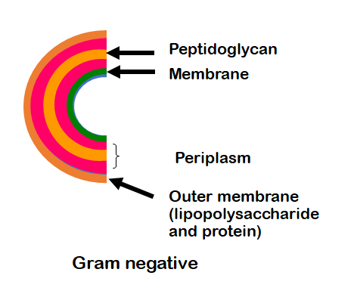
The Outer Membrane of Gram(-) Bacteria
Gram(-) contain an additional wall layer made of lipopolysaccharide (LPS).
LPS is a second lipid bilayer, but it is not constructed solely of phospholipid, as is the cytoplasmic membrane.
Instead it contains polysaccharide and protein.
The Iipids and polysaccharides are intimately linked in the outer layer to form specific LPS structures.

Slide 22
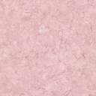
OUTSIDE
O-polysaccharide
Lipopolysaccharide
Lipid A
Core
polysaccharide
Porin
Gram-negative
outer membrane
8nm
Lipoprotein
Periplasm
Phospholipid
Peptidoglycan
Cytoplasmic membrane
INSIDE
Notes:
Porin: permeable to small molecules (hydrophilic LMW substance).

Slide 23
Chemistry of the LPS Layer
LPS polysaccharide consists of two portions:
-core polysaccharide
-O-polysaccharide (O-antigen or outer polysaccharide)
In Salmonella, the core polysaccharide consists of:
ketodeoxyocytonate (KDO),
seven-carbon sugars (heptoses),
glucose,
galactose,
NAG.

Slide 24
The LPS is composed of three distinct units
A phospholipid called Lipid A; It embeds Lipolysaccharide layer in the outer leaflet. Also known as endotoxin, it is responsible for toxic effects (fever and shock). Generally it is not released until death of cell.
A core polysaccharide of fiver sugars linked through ketodeoxyoctulonate (KDO) to lipid A
O antigen: An outer polysaccharide consisting of up to 25 repeating units of 3-5 sugars. These are hydrophilic in nature. O antigen is highly varied among species.

Slide 25
O-specific polysaccharide
Core-polysaccharide
Lipid A
P
KDO
P
Glu Nac
Gal
Hep
P
GlcN
KDO
Glu
Gal
Glu
Hep
Hep
KDO
GlcN
n
P
P
P
P
Notes:
LPS of Gram(-) Bacteria. The precise chemistry of lipid A and the polysaccharide components vary among species of gram(-) bacteria, but the sequence of major components (lipid A- KDO-core-O-specific) is generally uniform. The O-specific polysaccharide varies enormously among species.
KDO, ketodeoxyoctonate; Hep, heptose; Glu, glucose; Gal, galactose; GluNac, N-acetylglucosamine; GlcN, glucosamine.
The lipid A portion of the LPS layer can be toxic to animals and comprises the endotoxin complex .

Slide 26
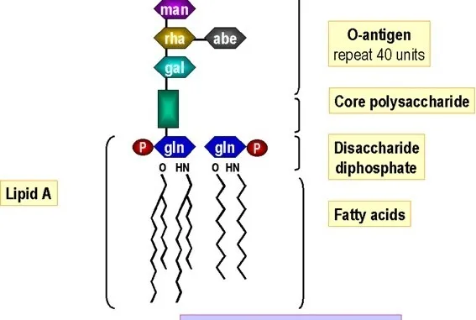
Structural Unit of Lipopolysaccharide Source: South Carolina School of Medicine

Slide 27
O-polysaccharide usually contains:
-galactose,
-glucose,
-rhamnose,
-mannose
-unusual dideoxy sugars (e.g. abequose, colitose, paratose, or tyvelose).
These sugars are connected in four- or five-membered sequences, which often are branched. When the sugar sequences are repeated, the long O-polysaccharide is formed.
Six-carbon sugars

Slide 28
LPP: Lipoprotein
A lipoprotein complex is found on the inner side of the outer membrane of a number of Gram(-) bacteria.
This lipoprotein is a small (approx. 7,200 MW) protein that serves as an anchor between the outer membrane and peptidoglycan.
In the outer leaf of the outer membrane, LPS replaces phospholipids; phospholipids are found predominantly in the inner leaf.

Slide 29
Gram Positive
Gram Negative
Gram reaction
Peptidoglycan layer
Teichoic acids
Periplasmic space
Outer membrane
Lipopolysaccharide (LPS) content
Lipid and lipoprotein content
Flagellar structure
Toxins produced
Resistance to physical disruption by lysozyme.
Susceptibility to penicillin and sulfonamide.
Susceptibility to streptomycin
Chloramphenicol and tetracycline
Inhibition by basic dyes
Susceptibility to anionic detergents
Resistance to sodium azide
Resistance to drying
Retain crystal violet dye and stain dark violet or purple
Thick (multilayered)
Present in many
Absent
Absent
Virtually none
Low (acid-fast bacteria have lipids linked to peptido-glycan)
2 rings in basal body
Primarily exotoxins
High
High
Low
High
High
High
High
High
Can be decolourized to accept (safranin) and stain red
Thin (single-layered)
Absent
Present
Present
High (due to presence of outer membrane)
4 rings in basal body
Primarily endotoxins
Low (requires pretreatment to destabilize outer membrane)
Low
High
Low
Low
Low
Low
Low

Slide 30
End of Chapter 1!
Thank you

